Slide 1

Database Auditing &
Security System
HITEC University Taxila
Shah Sayed Meran (24-CS-087) | Assam Sajjad (24-CS-236)
Submitted to: Sir Waqar Ismail

Slide 2









The Problem We Are Solving
Frontend Bypass
No History
Structural Threats
Hackers or rogue staff often bypass websites to access database engines directly, leaving no traces.
Standard databases only store current data. They don't save what the value was *before* a malicious change.
Unauthorized users can accidentally drop tables or alter critical structures, causing permanent data loss.

Slide 3


Our Proposed Solution
Moving Security into the Database
Build security entirely inside Microsoft SQL Server.
Security logic is "Inescapable" because it lives in the engine.
Real-time automated logging of every single modification.
Automatic rollback of unauthorized structural changes.

Slide 4






System Core Features
Data Auditing
Schema Guard
Access Control
Tracks updates and deletes. Saves "Who", "When", and "What" (Old vs New values).
Prevents dropping or altering tables by non-admins using DDL triggers.
Restricts direct data entry. Users must use secure Procedures with role checks.

Slide 5
DML Trigger: The Security Camera
Automatic Tracking
100%
We use DML Triggers to monitor the Financial_Records table. Every time a value is changed:
The system grabs the system username.
It records the exact timestamp.
TRANSPARENCY
It stores the Old Balance and New Balance.

Slide 6

Schema Guard
Structural Protection
Our system uses DDL Triggers to watch the entire database structure.
If anyone tries to run a DROP TABLE or ALTER TABLE command, the system intercepts it instantly.
Result: An alert is logged, and the command is rolled back automatically. The data structure remains safe!
This Photo by Unknown Author is licensed under CC BY

Slide 7
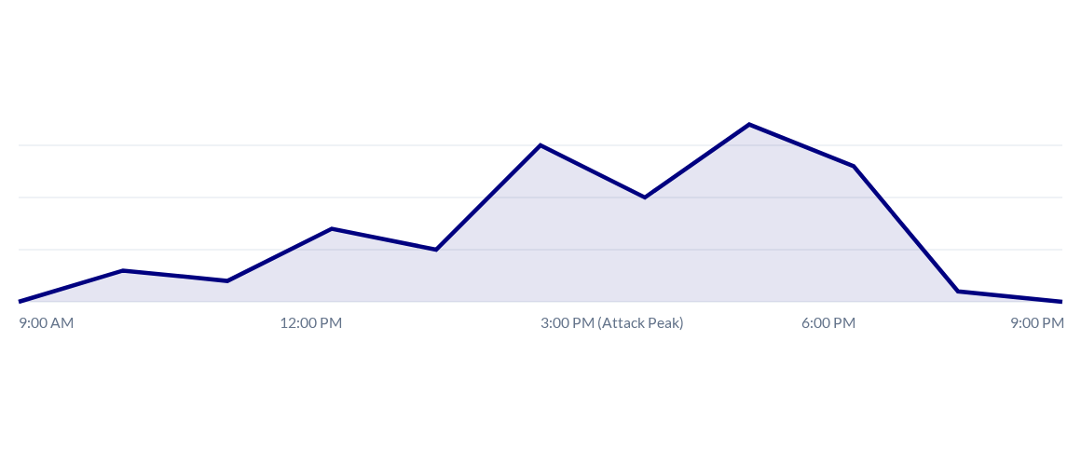
Risk Detection & Activity Trends
Identifying "High Risk" spikes using Scalar Functions to detect rapid-fire hacks.

Slide 8








Technology Stack
MS SQL Server
T-SQL
SSMS
The robust database engine hosting our secure schemas.
Advanced procedural language used for Triggers and Logic.
Management Studio used for design and performance monitoring.

Slide 9
Future Scaling & Extensibility
API Layer
Admin UI
AI Insights
Cloud Migration
Java Spring Boot integration for secure web access.
React dashboard for real-time audit visualization.
Predicting future breaches using machine learning.
Scaling to Azure/AWS for global data availability.

Slide 10

Thank You!
Any Questions?
Shah Sayed Meran & Assam Sajjad
Department of Computer Science | HITEC University

